Slide 1

Fake Product Identification PROJECT PROPOSAL
Submitted To: Dr. Muhammad Hataba
Eng. Marwa Azab

Slide 2
Table of contents
01
02
03
Introduction
BackEnd
FrontEnd

Slide 3
INTRODUCTION
01

Slide 4
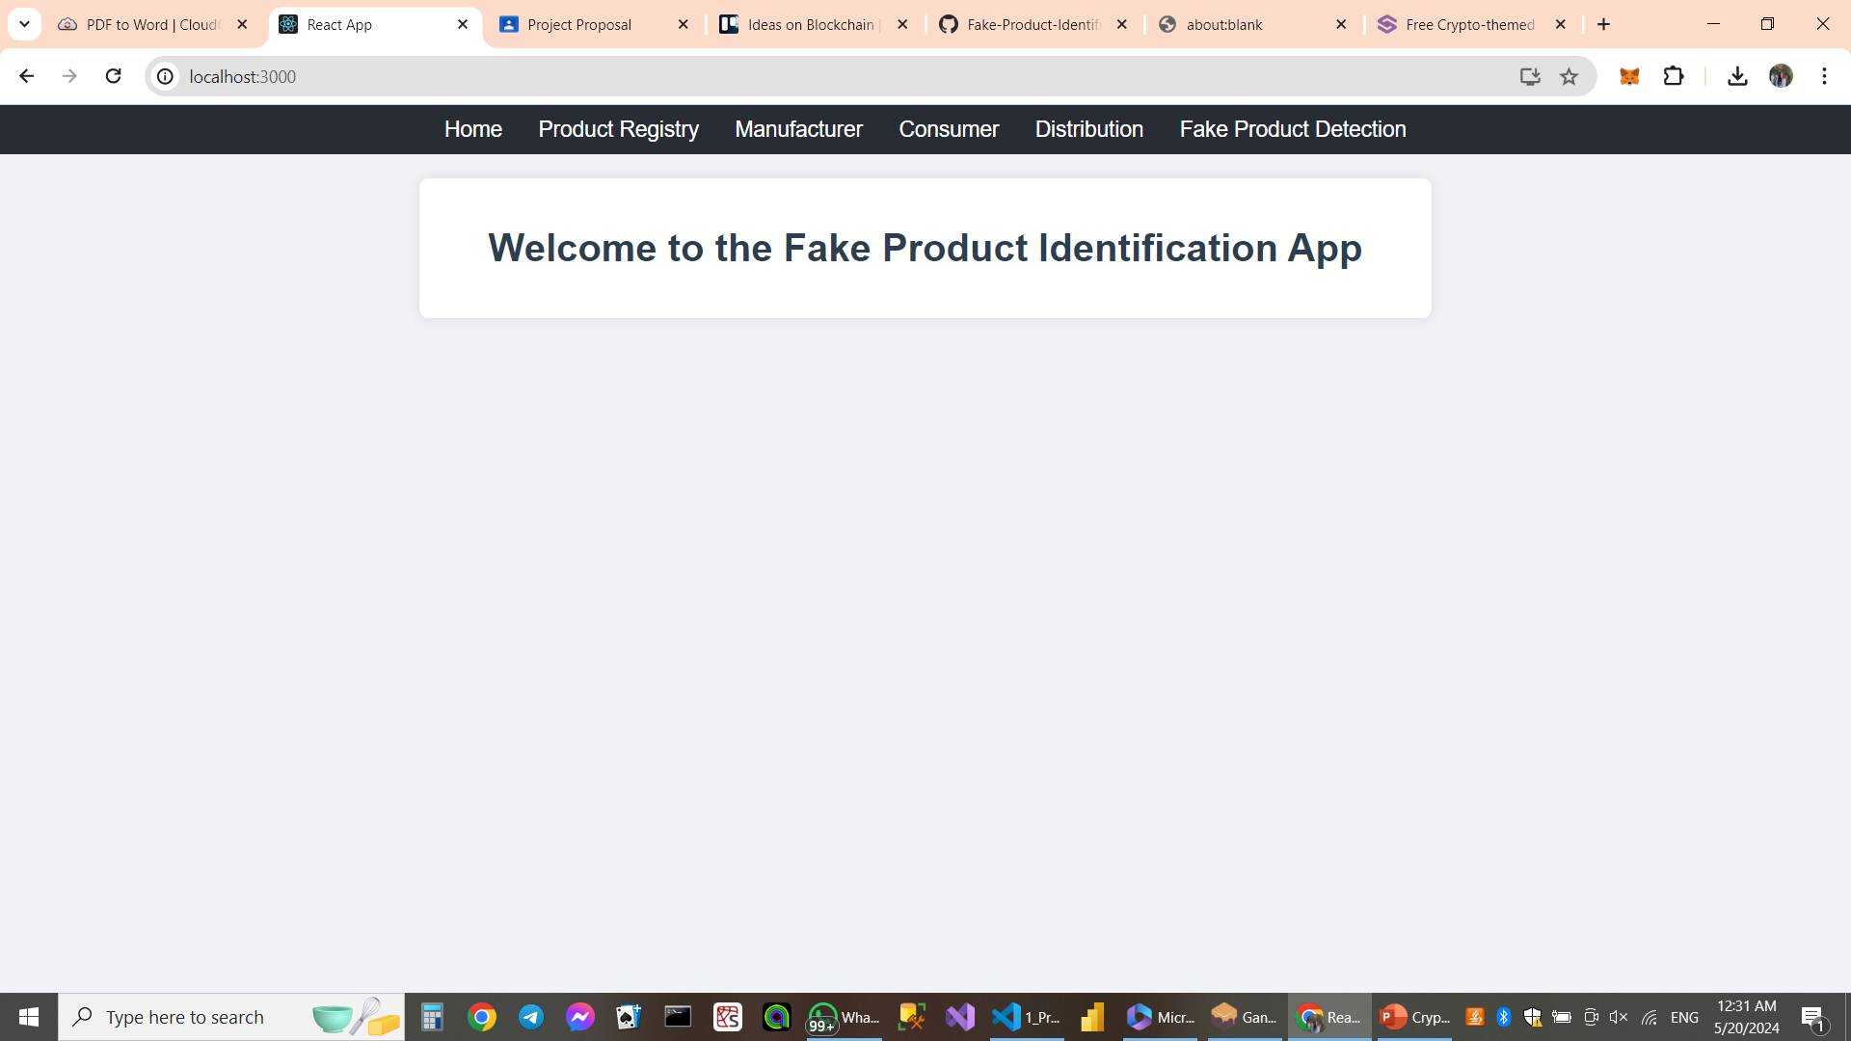

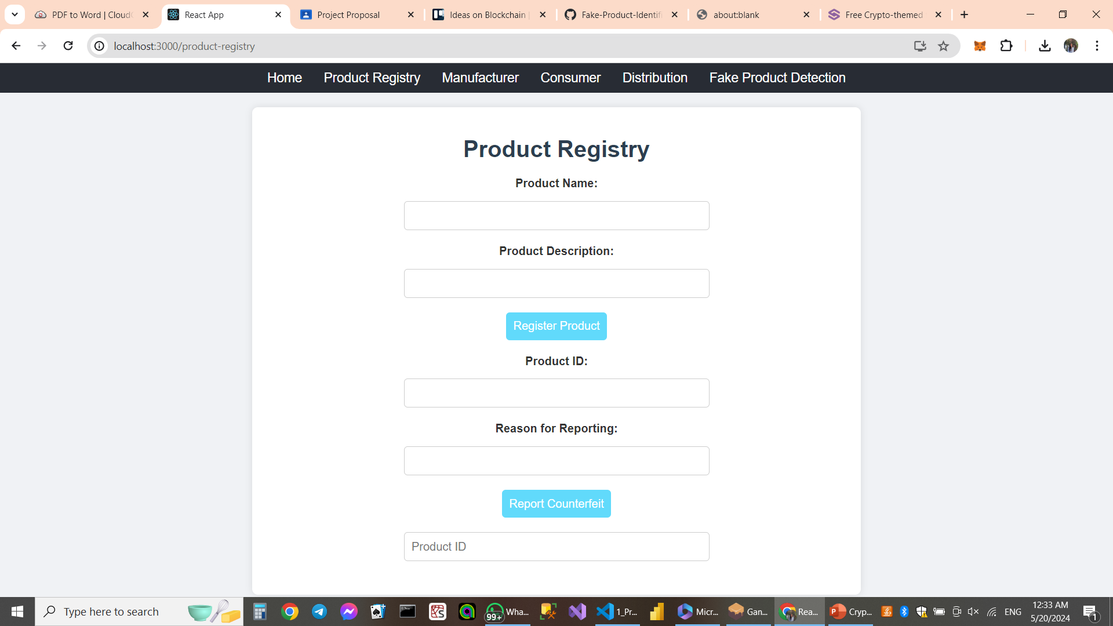

Slide 5
BACKEND
02

Slide 6



What are we working on?
VScode
Ganache
Using Solidity
Using Truffle

Slide 7
Contracts
1. Product Registry
2. Manufacturer
3. Consumer
4. Distribution
5. Fake Product Detection/ Registration
VsCode

Slide 8
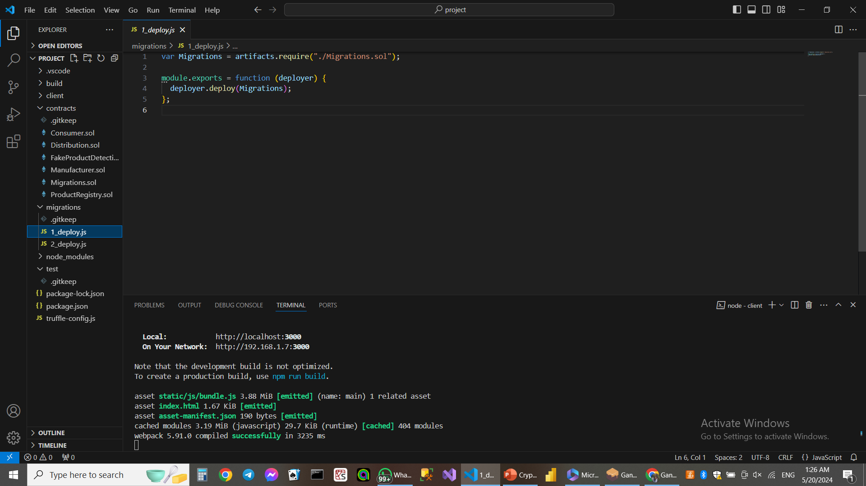
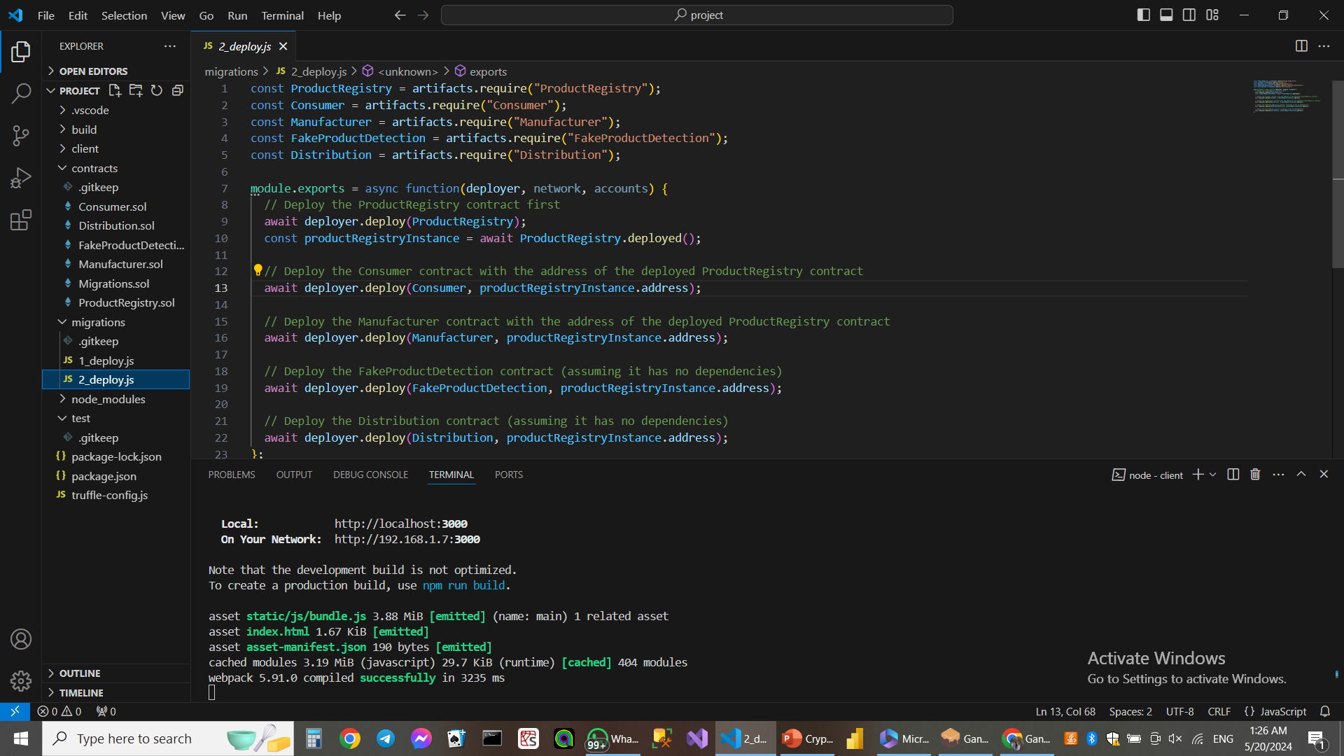
Ganache

Slide 9
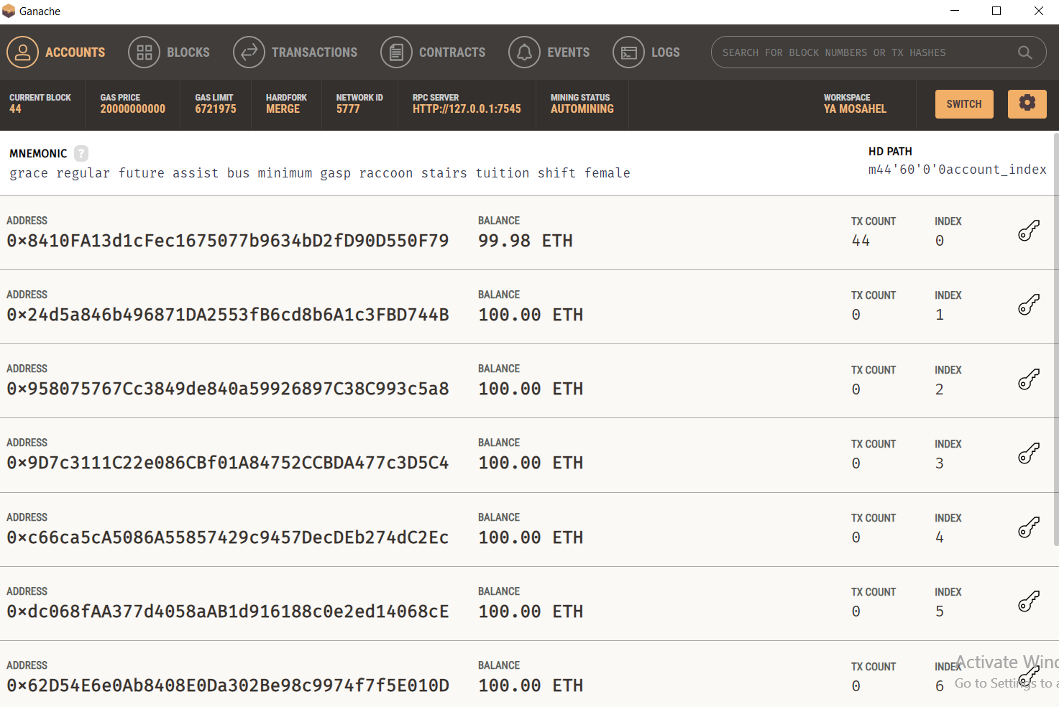

Slide 10
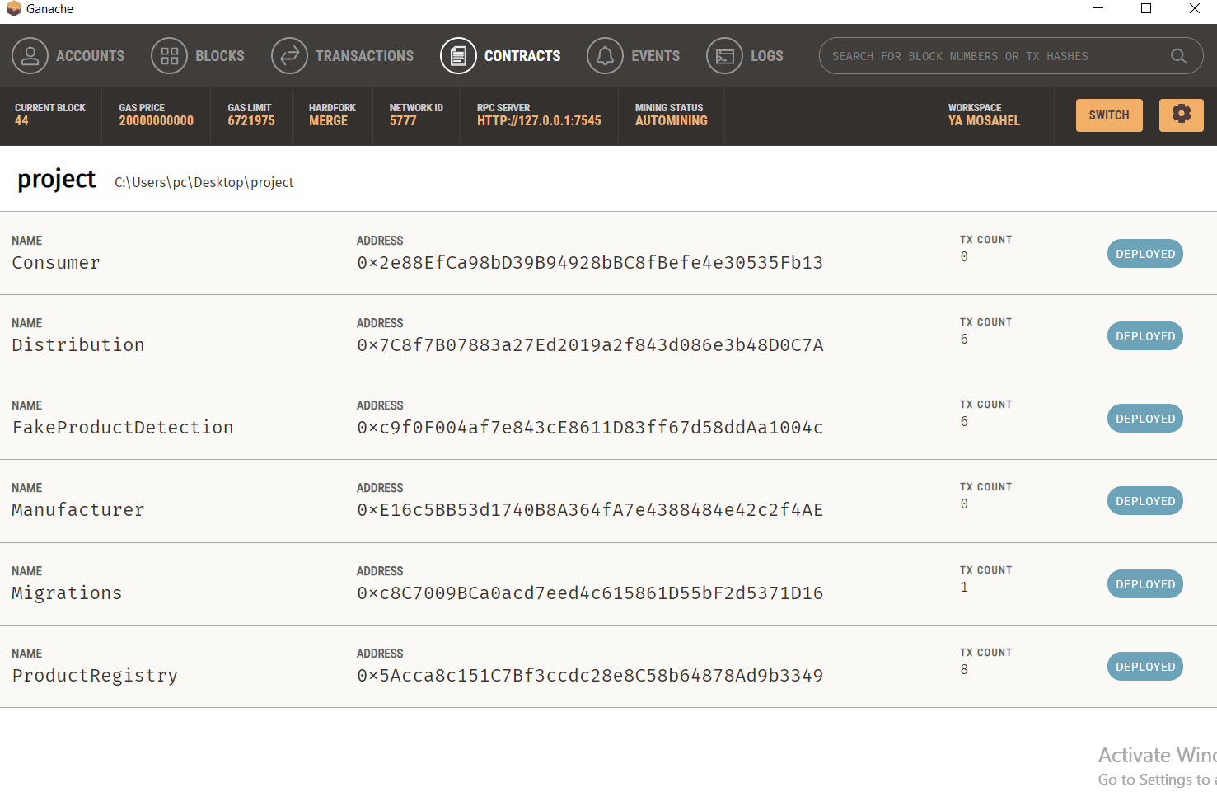

Slide 11
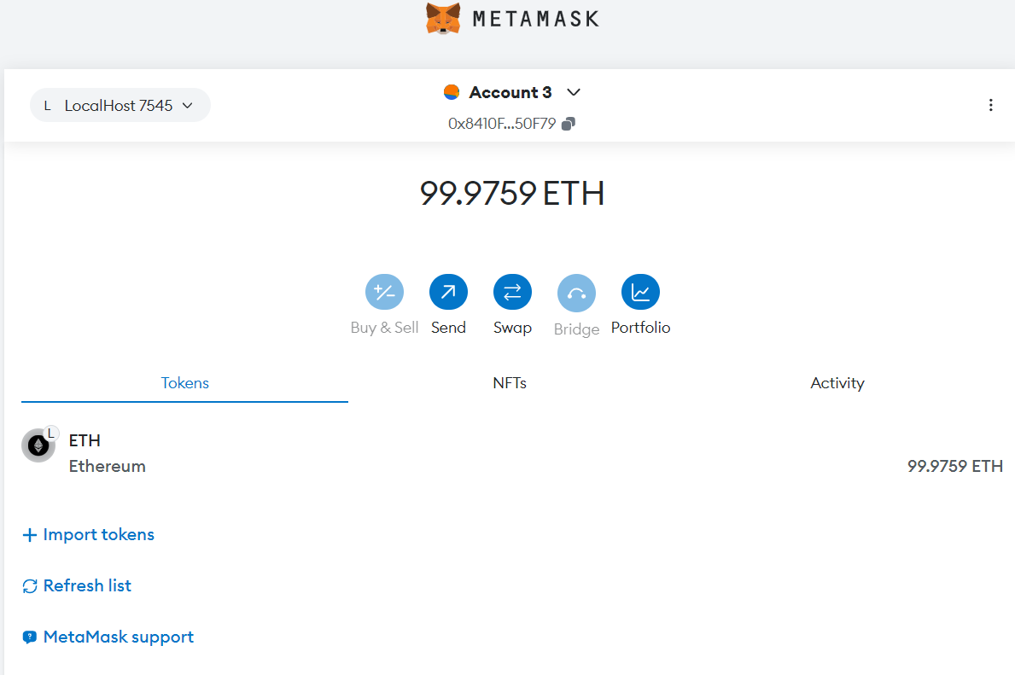
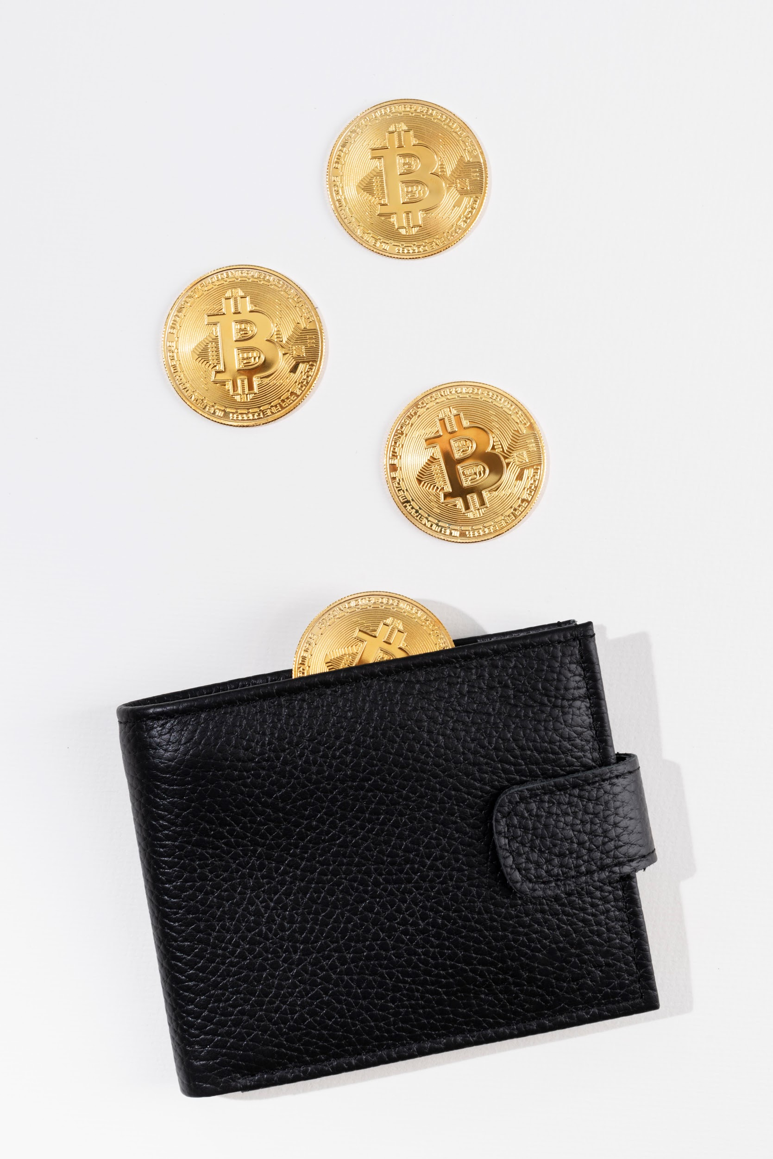

Slide 12
FRONTEND
03

Slide 13
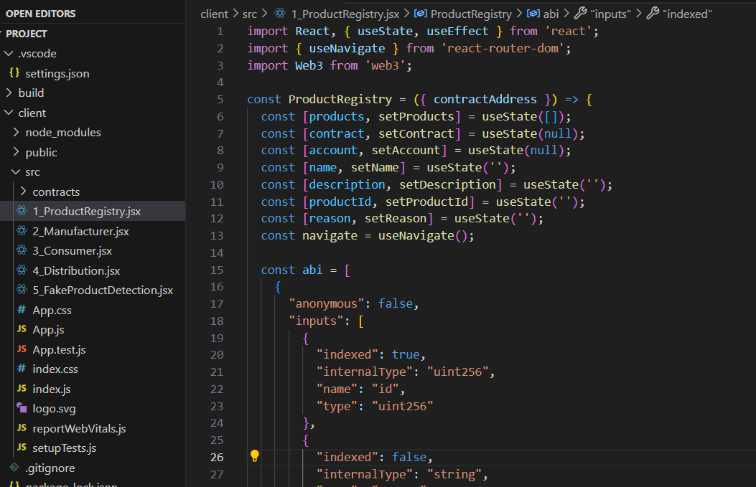

Slide 15
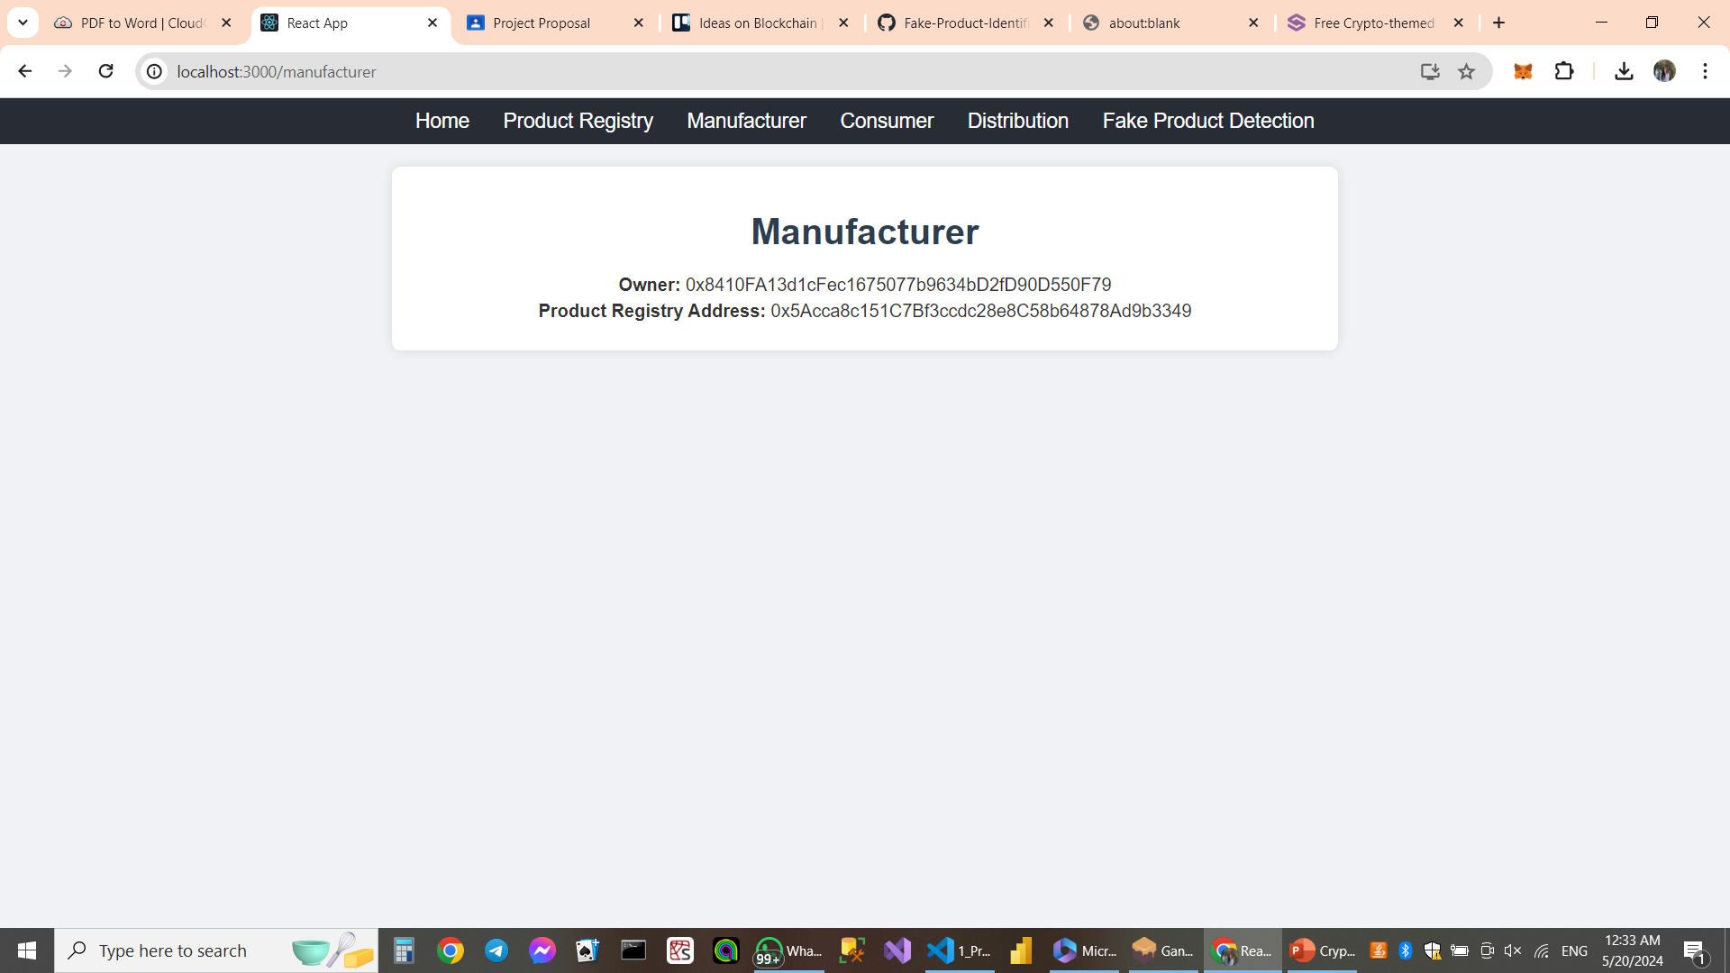
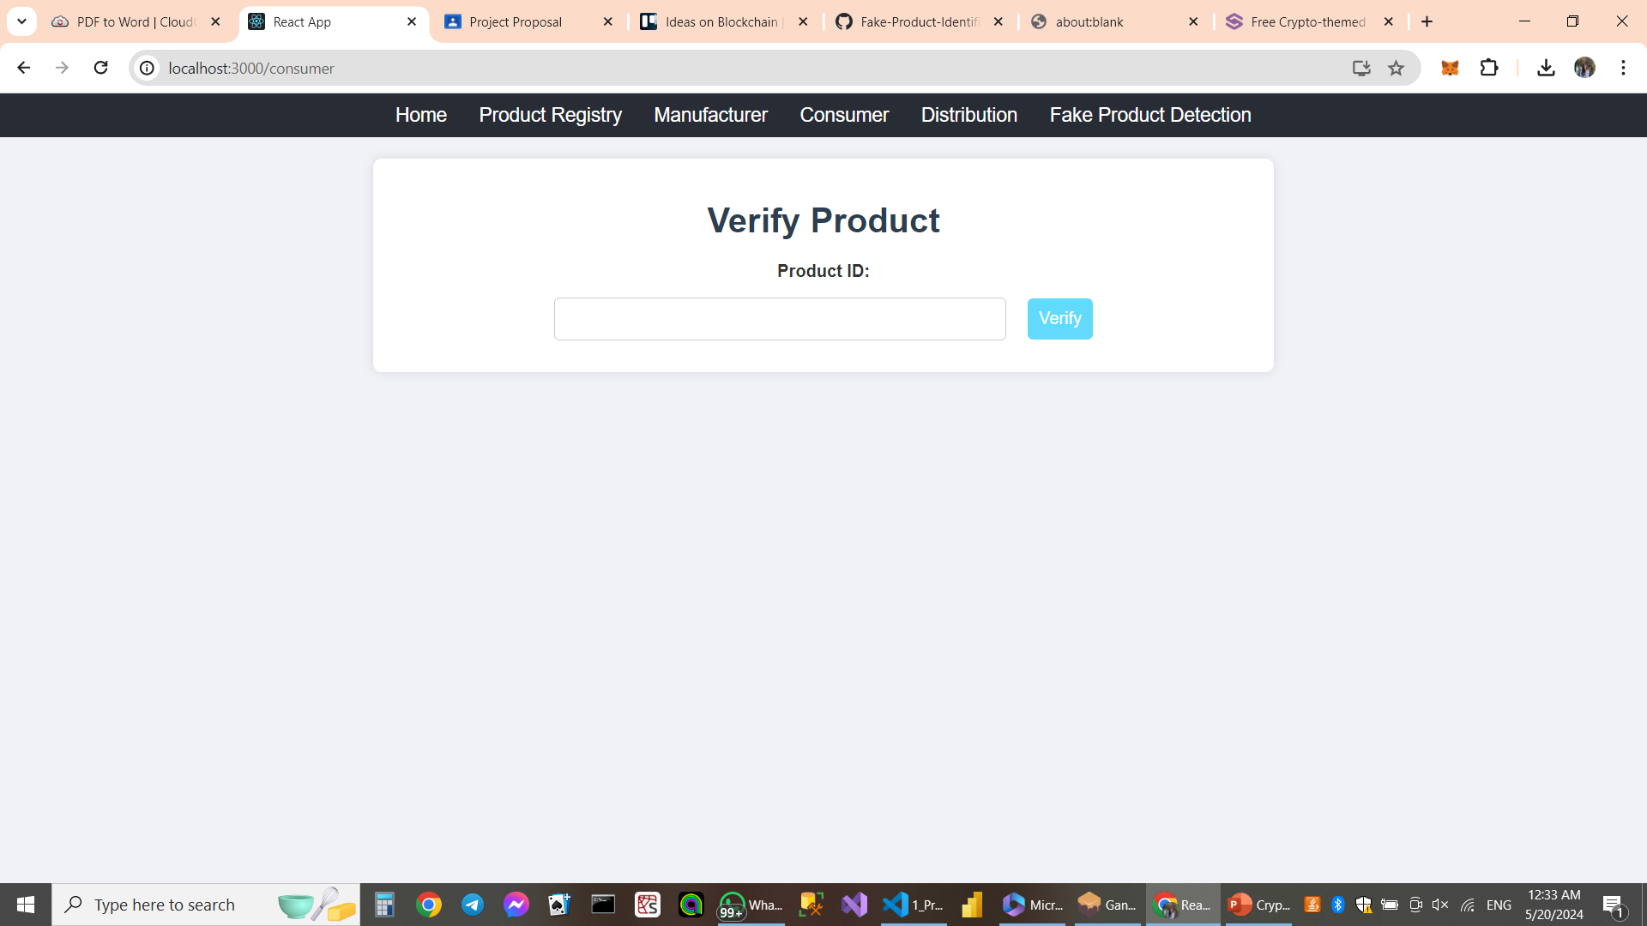

Slide 16
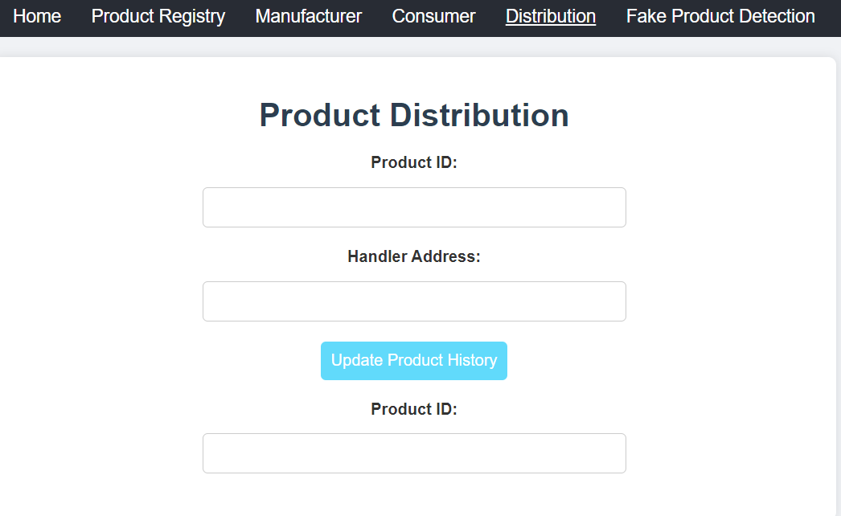

Slide 17
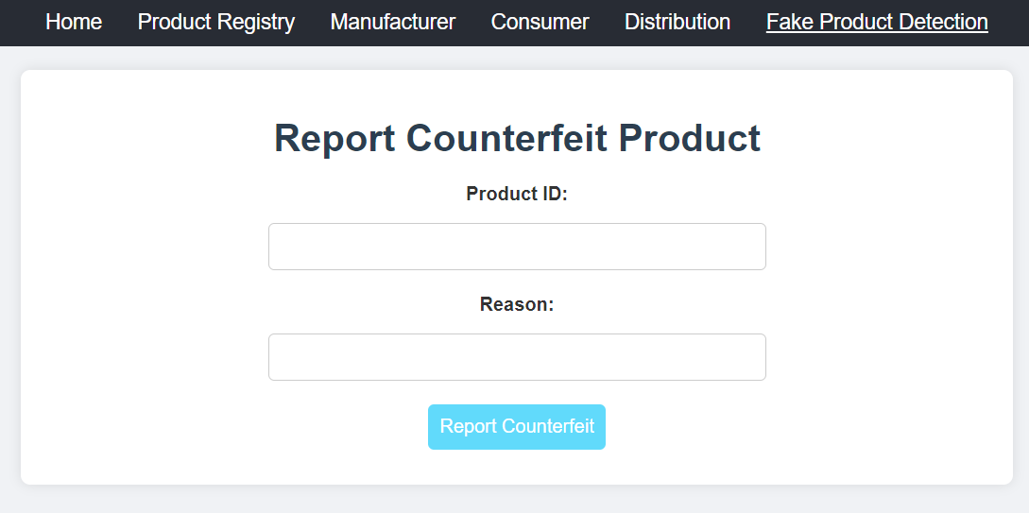

Slide 18


Slide 19
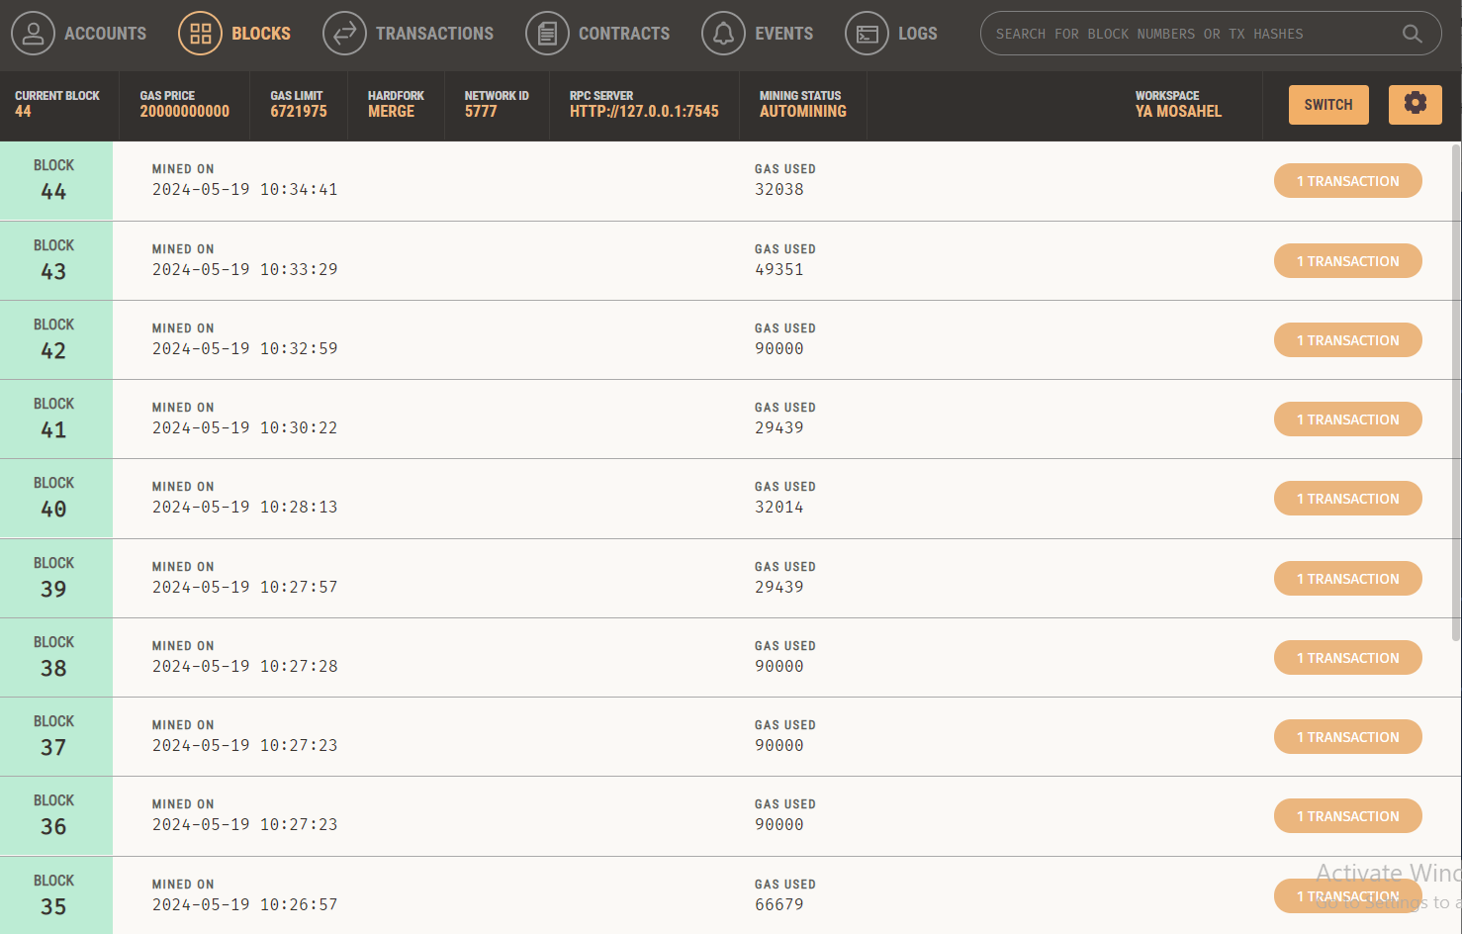

Slide 20


THANK YOU

